Slide 1
DPS/ESE Semester Project:
Truck Platooning
Group 2
Aishwary Panchal ESE 7224347
Abdelrahman Abdin Mousa Abdin ESE 7223296
Girsy Guzmán Garcia ESE 7224626
Amin Elkasaby ESE 7224933

Slide 2
Ese

Slide 3
Use cases of the system
Standard platooning
Emergency braking
Communication failure
Joining/Leaving the platoon

Slide 4
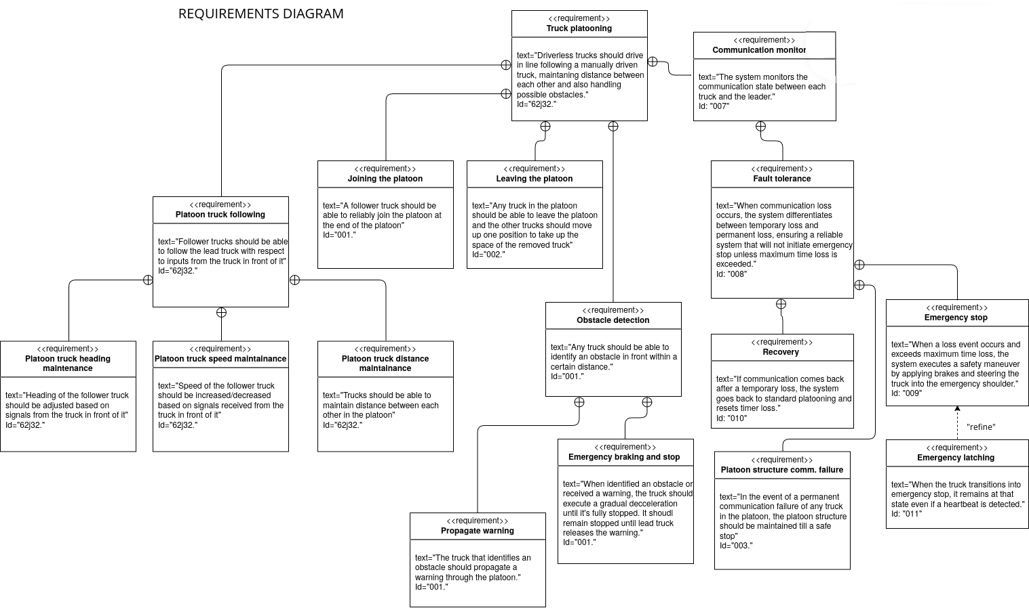
SYSTEM REQUIREMENTS

Slide 5
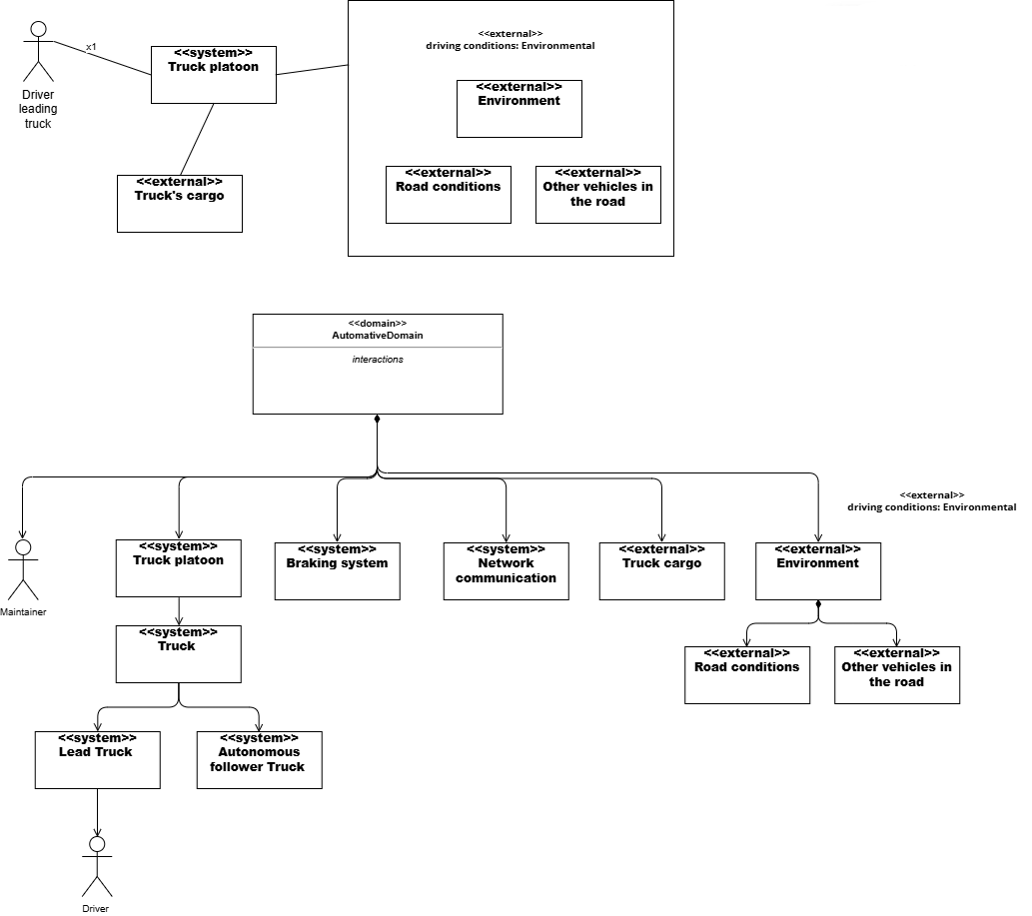
Context diagram

Slide 6
Block definition diagram

Slide 7
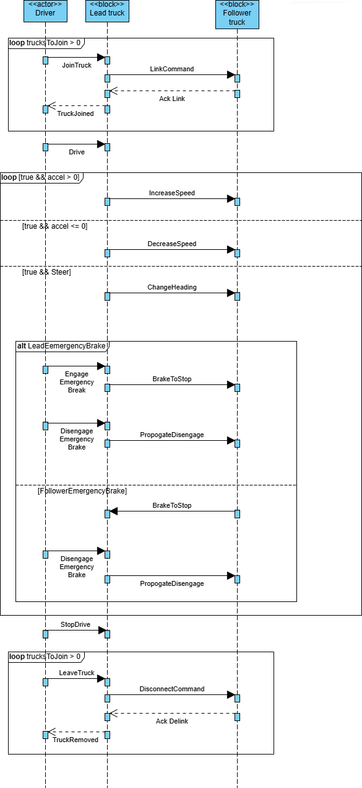
Sequence diagram

Slide 8
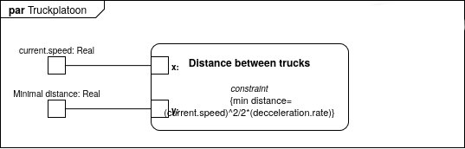
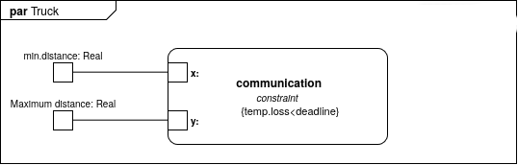
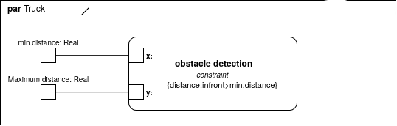
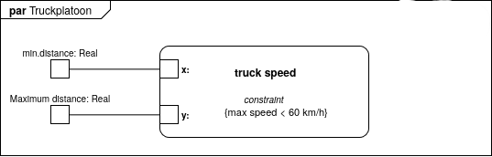
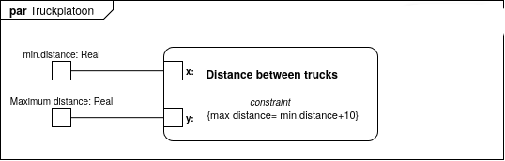
Parametric constraints diagrams

Slide 9
Allocation diagrams

Slide 10
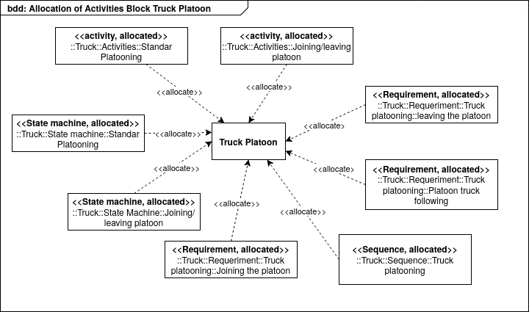

Slide 11
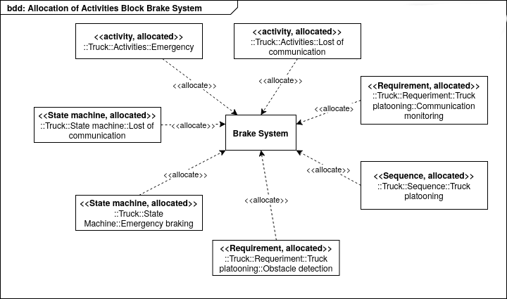

Slide 12
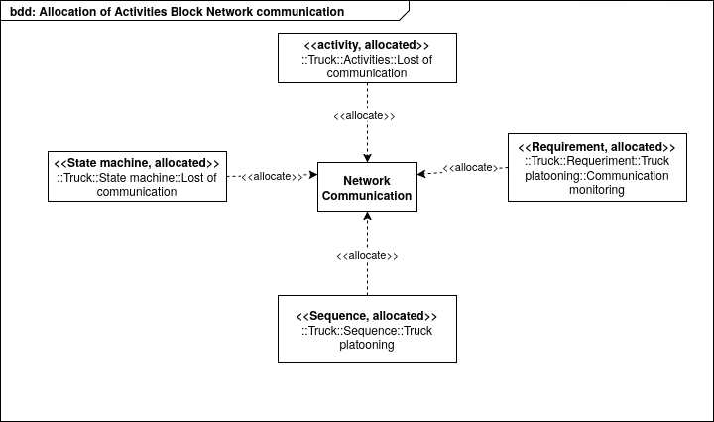

Slide 13
Internal block diagrams

Slide 14
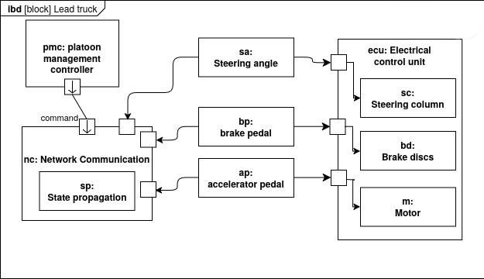

Slide 15
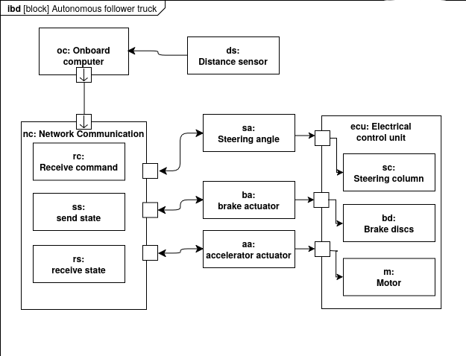

Slide 16
State machines

Slide 17
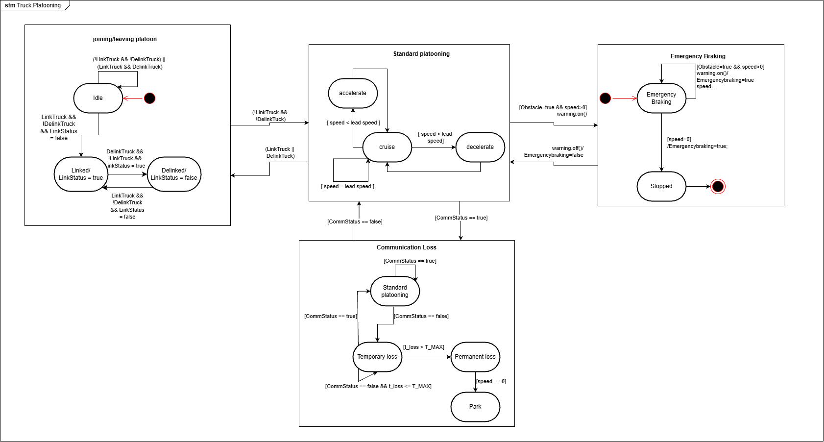

Slide 18
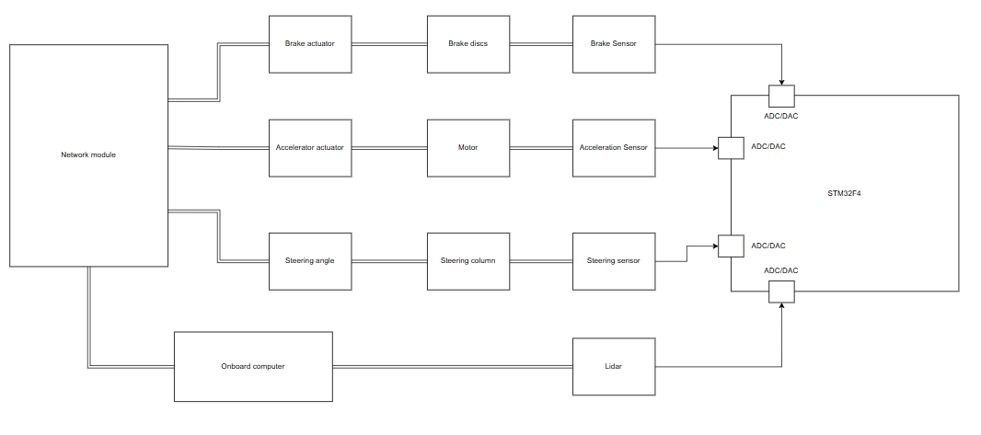
Mapping to prototype hardware

Slide 19
scheduling
Chosen Hardware: STM32F4 series
  CPU: ARM Cortex – M4
  Frequency: 168 MHz
For Follower truck:
Task id | Task name | Period (ms) | WCET (µs) | Deadline (ms) | Priority
T1 | Control loop | 16 | 12 | 16 | Critical
T2 | Safety Monitoring | 50 | 2.2 | 50 | High
T3 | Communication link check | 100 | 0.7 | 100 | Medium

Slide 20
scheduling
Chosen Hardware: STM32F4 series
  CPU: ARM Cortex – M4
  Frequency: 168 MHz
For Lead truck:
Task id | Task name | Period (ms) | WCET (µs) | Deadline (ms) | Priority
T1 | Control loop | 16 | 2 | 16 | Critical
T2 | Communication link check | 100 | 0.7 | 100 | Medium

Slide 21
scheduling
Utilities for lead and follower trucks calculated using Σ (c_{i} / t_{i}):
  U (follower) = 12/16000 + 2/50000 + 0.7/100000 = 0.000797
  U (lead) = 2/16000 + 0.7/100000 = 0.000132
For EDF schedulability, the U of the tasks of the components should be less than or equal to 1 and since both utilities are less than 1, both of them are schedulable via EDF

Slide 22
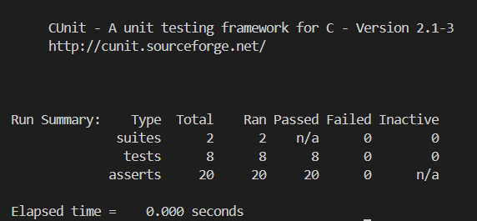
Validation and verification
We have done unit testing using CUnit as well as defect testing

Slide 23
Fault tree analysis

Slide 24
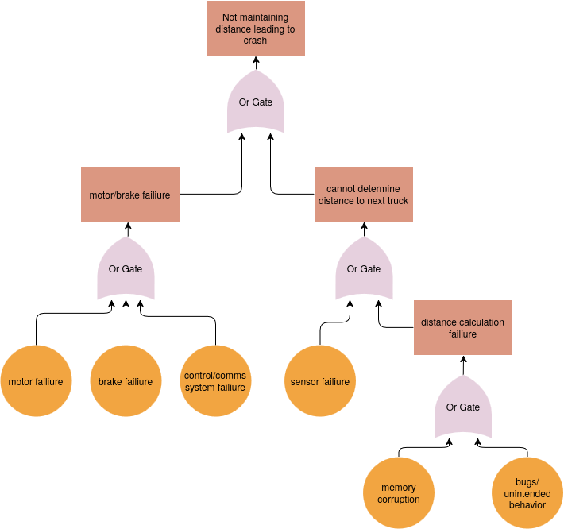
Standard platooning

Slide 25
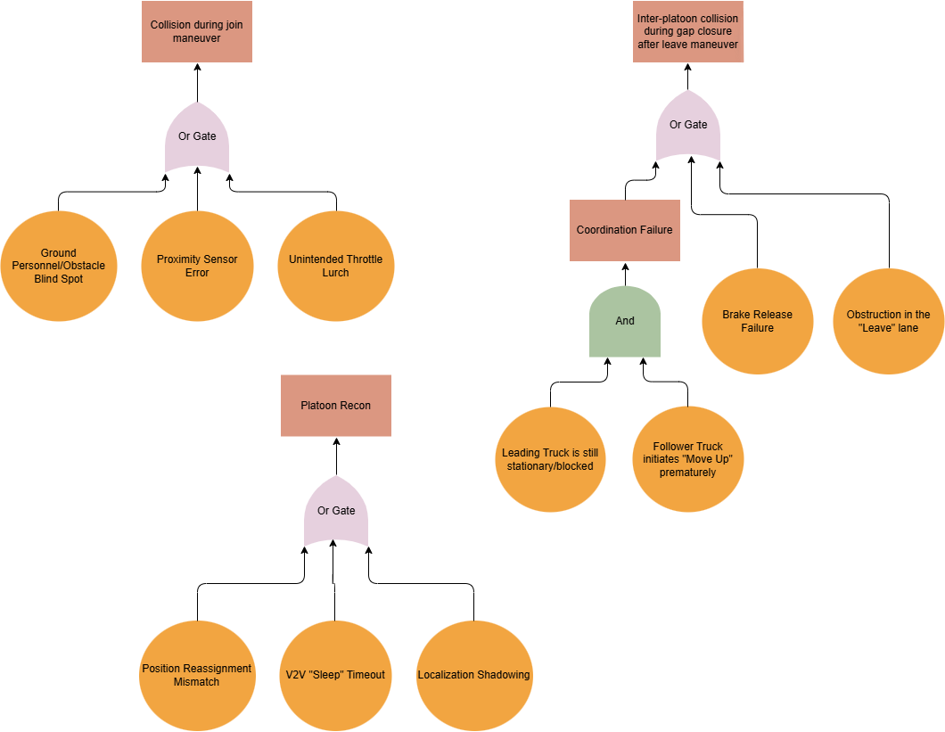
Joining/leaving platoon

Slide 26
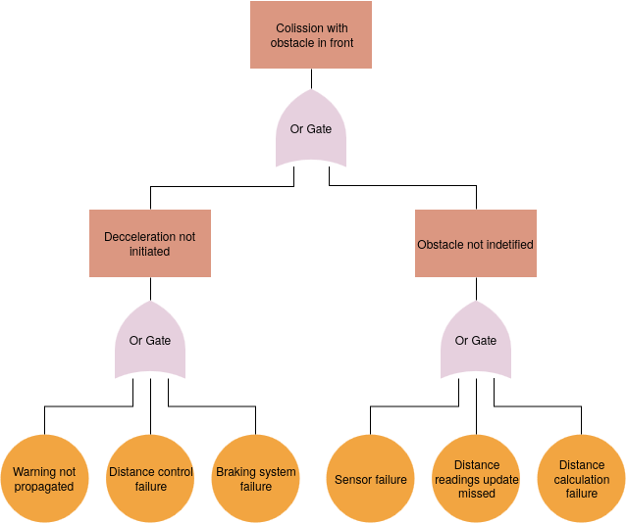
Emergency braking

Slide 27
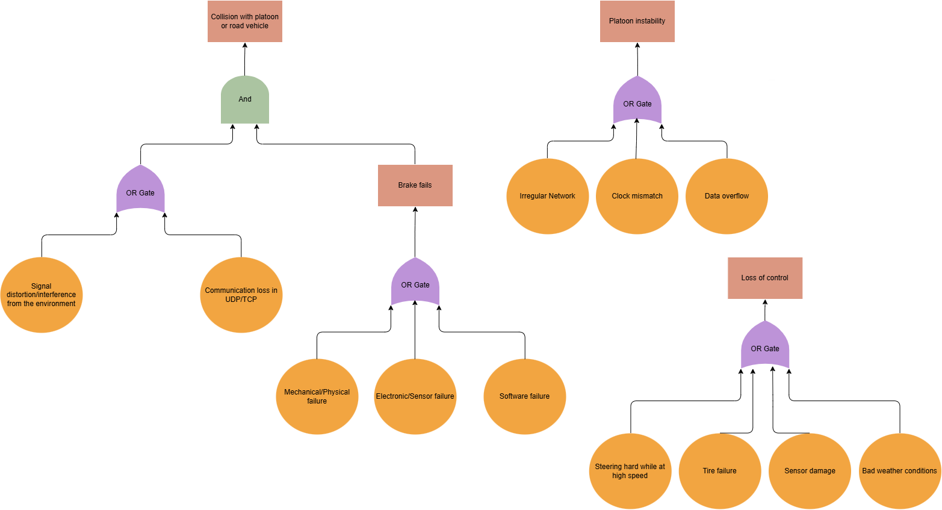
Communication failure

Slide 28
dps

Slide 29
Use cases of the system
Standard platooning
Emergency braking
Communication failure
Joining/Leaving the platoon

Slide 30
Standard platooning

Slide 31
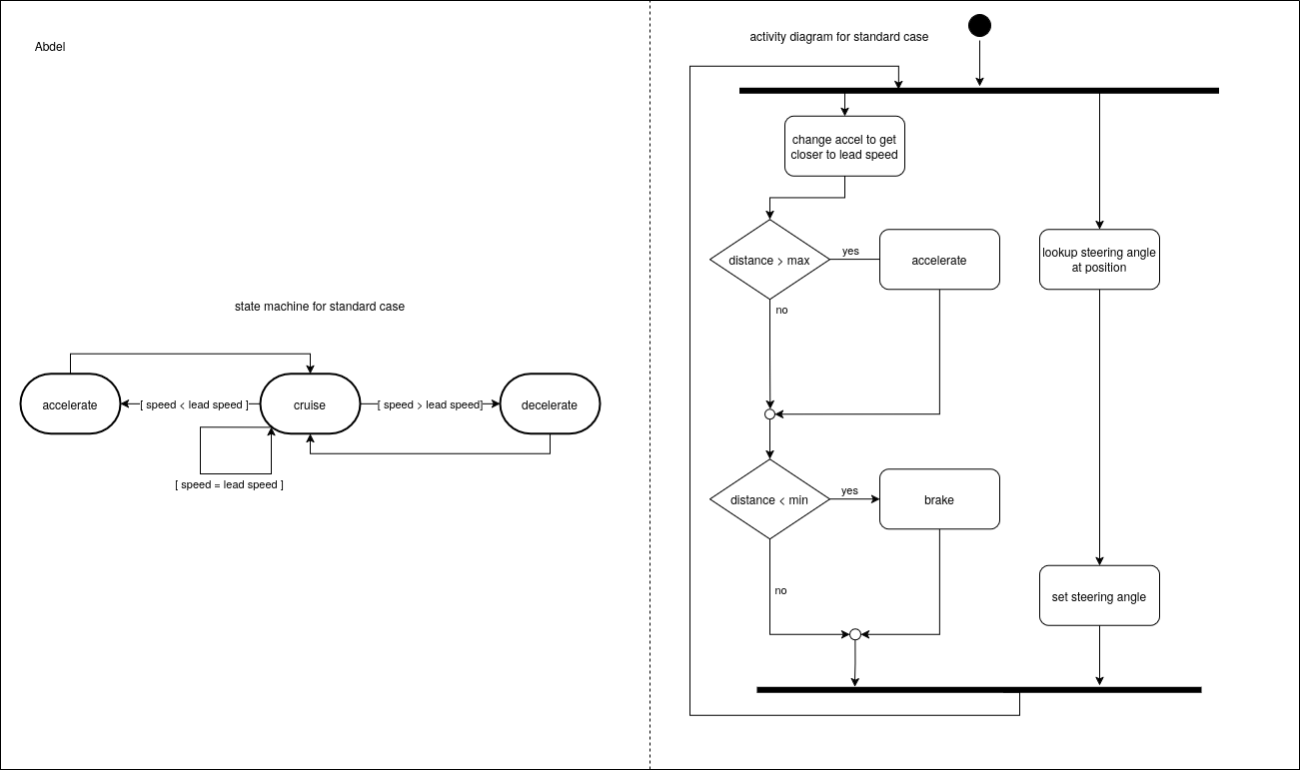

Slide 32
Joining/leaving platoon

Slide 33
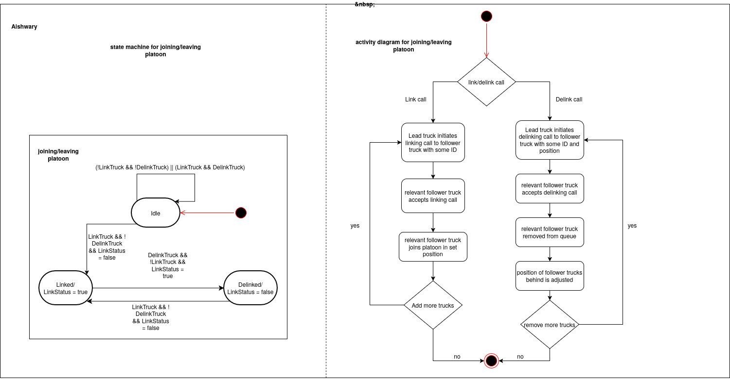

Slide 34
Emergency braking

Slide 35
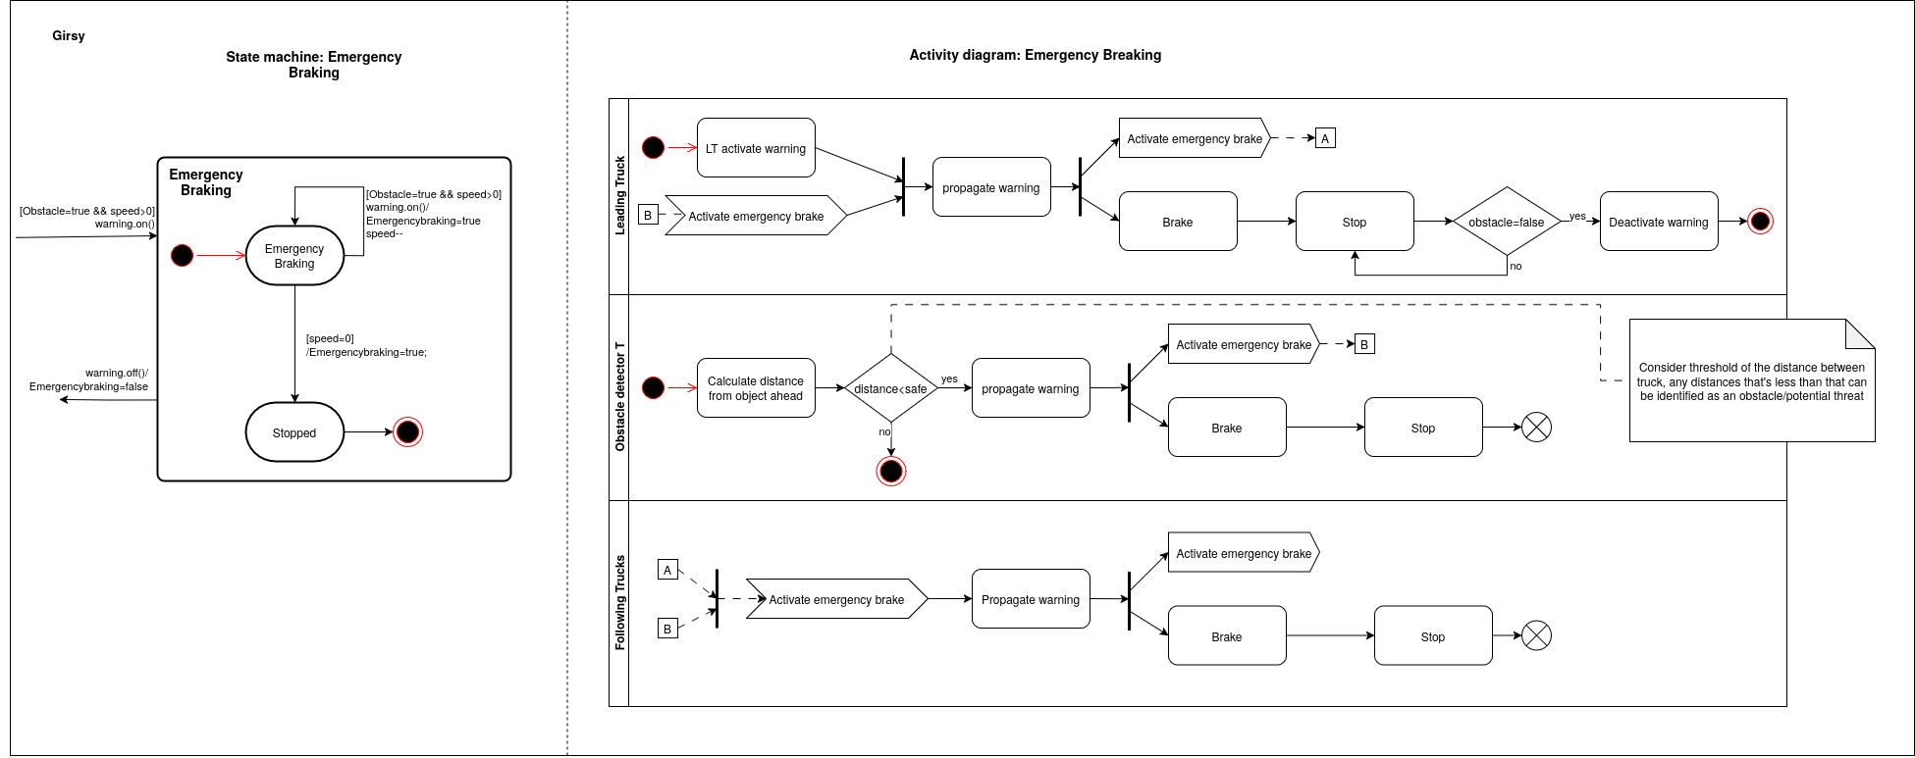

Slide 36
Communication failure

Slide 37
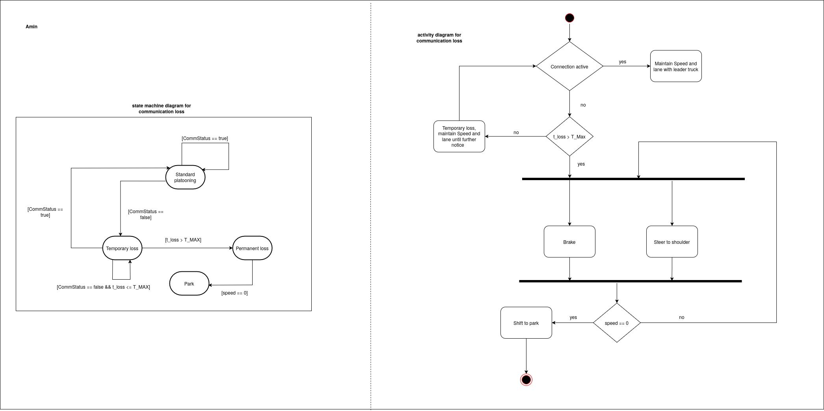

Slide 38
Thank you

